Slide 1

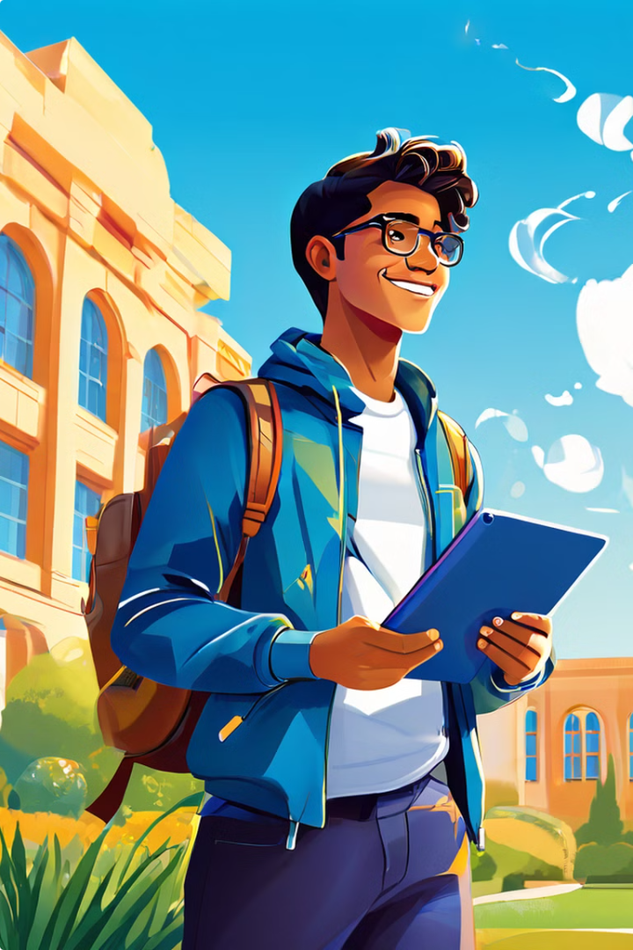
Autobiography
This autobiography is a personal reflection of my life journey, from childhood to university education. It explores my educational background, cultural influences, key milestones, challenges, and lessons learned. It also highlights my values and beliefs that have shaped who I am today.
Vincent njagi

Slide 2

About the Author
My name is Vincent Njagi, and I am a student at the Dedan Kimathi University of Technology. I am pursuing a degree in Computer Science and Information Technology. I am passionate about technology and its potential to solve real-world problems.
Name
Registration Number
Vincent Njagi
c027-01-0719/2021
School
School of Computer Science and IT

Slide 3

Education Background
My education journey has been a series of transformative experiences, from early childhood to higher education. Each stage has played a vital role in shaping my knowledge, skills, and values.
1
Kindergarten
I attended kindergarten at a local preschool, where I developed basic literacy and numeracy skills.
2
Primary School
I continued my education in primary school, where I received a solid foundation in core subjects like mathematics, science, and language.
3
Secondary School
During my secondary education, I specialized in science and technology, which ignited my passion for computer science.
4
University
I am currently pursuing a degree in Computer Science and Information Technology at Dedan Kimathi University of Technology.

Slide 4
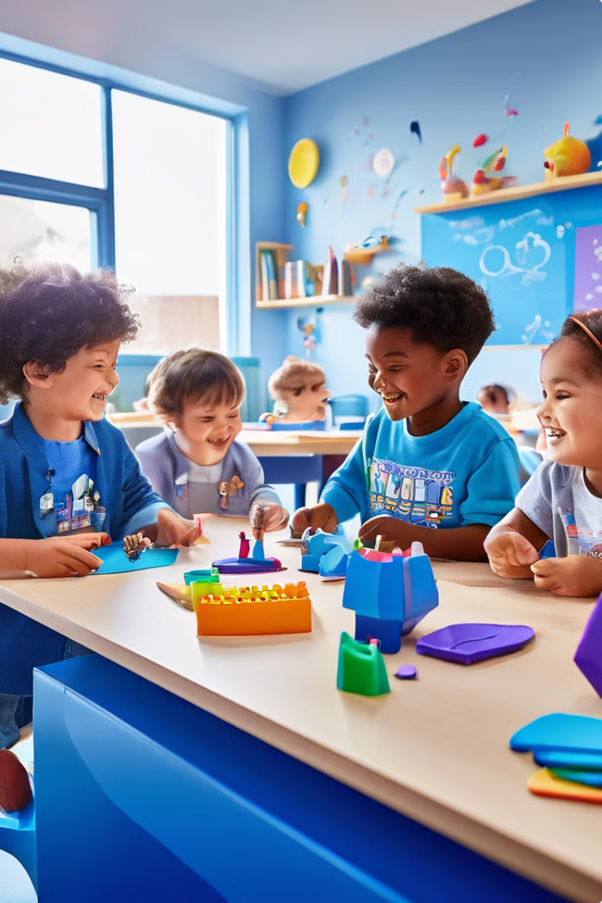
Kindergarten Education
My kindergarten experience was a foundation for my early learning. I developed essential social skills and learned basic concepts that prepared me for primary school.
1
Socialization
2
Language Skills
I interacted with other children, learning to share and cooperate.
I learned the basics of reading, writing, and speaking English.
3
Early Numeracy
4
Creativity
I developed a foundation in counting, sorting, and recognizing shapes.
I participated in art and craft activities, fostering my imagination.

Slide 5
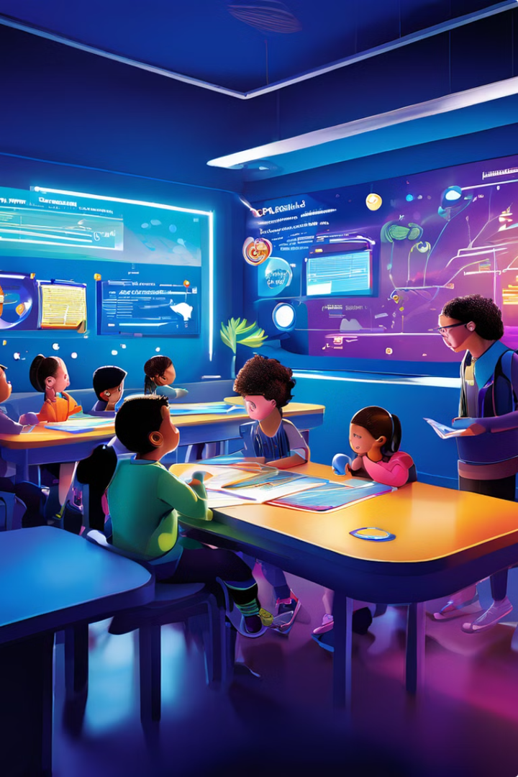
Primary Education
Primary school provided me with a solid foundation in core subjects, developing my academic skills and instilling a love for learning. I enjoyed math and science classes. I also participated in extracurricular activities like sports and drama.
Subject
Key Learnings
Mathematics
Algebra, geometry, arithmetic
Science
Biology, chemistry, physics
Language
Reading, writing, speaking
Social Studies
History, geography, civics

Slide 6
Secondary Education
Secondary school was a period of significant academic growth. I pursued a science stream, developing my interest in technology and computer science. I enjoyed the challenges of solving complex problems and learning new concepts.
Science and Technology
Computer Studies
Extracurricular Activities
I took advanced courses in physics, chemistry, biology, and mathematics.
I learned about computer hardware, software, and programming languages.
I participated in sports, drama, and debate clubs.

Slide 7
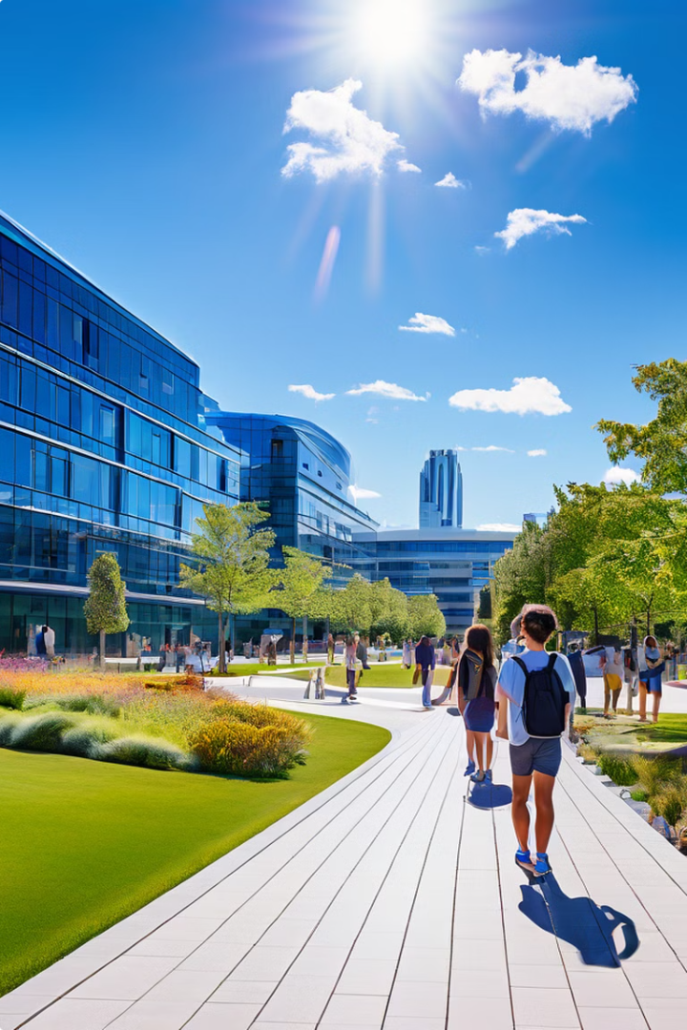



University Education
My university journey at Dedan Kimathi University of Technology has been an exciting and rewarding experience. I am pursuing a degree in Computer Science and Information Technology, and I am eager to contribute to the field.
First Year
I took introductory courses in programming, data structures, and computer architecture.
Second Year
I focused on more advanced concepts like software engineering, databases, and operating systems.
Third Year
I am currently studying specialized courses in artificial intelligence, cybersecurity, and cloud computing.

Slide 8





Conclusion
My autobiography reflects a journey of growth, discovery, and learning. I am grateful for the experiences and opportunities that have shaped me into the individual I am today. As I continue my education and career, I am driven by a passion for technology and a desire to make a positive impact on the world.
Technology
Continuous Learning
My passion for technology motivates my career choices.
I embrace lifelong learning and strive for continuous improvement.
Innovation and Creativity
Collaboration
I am driven by a desire to find innovative solutions to challenges.
I value teamwork and believe in the power of collaboration.

